Slide 1

Python Scripting with Network
Day 11

Slide 2

Agenda
Network Monitoring Automation
Working with Ansible
YAML based automation
Python JINJA library
Python NAPALM Library

Slide 3
Python Network Controller API
Python network monitoring automation allows engineers to track device availability, gather performance metrics, and alert teams to anomalies without human intervention.
By combining structured scripting with purpose-built networking libraries, you can transition from manual CLI checks to programmatic, proactive management.
NAPALM: Implements a unified, vendor-agnostic API for cross-platform data collection.
Nornir: Functions as a pluggable multi-threaded framework to manage vast device inventories simultaneously.
Scapy: Offers advanced packet manipulation and real-time deep packet analysis.
NCClient: Handles client-side scripting for XML-based NETCONF APIs on modern switches.

Slide 4
Working with Ansible
Ansible is an open-source IT automation engine written entirely in Python that uses declarative YAML files (Playbooks) to manage configurations, deploy software, and orchestrate infrastructure.
How Python and Ansible Interact
The Engine: Ansible runs on Python. It converts your YAML playbook tasks into small Python scripts behind the scenes.
The Control Node: The machine executing the commands requires a modern version of Ansible and Python 3.
The Managed Nodes: The target servers do not need Ansible installed, but they must have a Python interpreter to execute the pushed scripts.

Slide 5
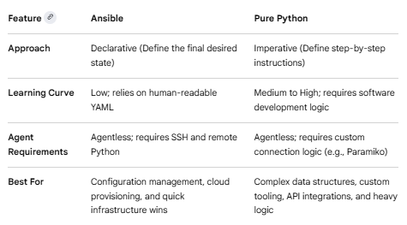
Python V/s Ansible Automation

Slide 6
Python JINJA library
Jinja is a fast, expressive, and highly extensible templating engine for Python. It allows you to generate dynamic HTML, XML, CSV, or plain text configuration files by combining raw text with special placeholders and programming logic. It is widely used in frameworks like Flask, FastAPI, and automation platforms like Ansible and dbt.
{{ ... }}: Expressions to print directly to the template output.
{% ... %}: Statements used for control logic like loops, macros, and conditions.
{# ... #}: Comments which are completely omitted from the final output
# ...: Line statements used as an alternative syntax to improve readability

Slide 7
Python NAPALM library
NAPALM (Network Automation and Programmability Abstraction Layer with Multivendor support) is a Python library that implements a set of functions to interact with different network device Operating Systems using a unified API.
Arista EOS
Cisco IOS
Cisco IOS-XR
Cisco NX-OS
Fortinet Fortios
IBM
Juniper JunOS
Mikrotik RouterOS
Palo Alto NOS
Pluribus
Vyos

Slide 8
Wrap Up
Python Automation for Network engineering
Python Network Libraries
Python Modules
Python Lambda Functions

